Slide 1
Welcome To
CSCI 6433
Internet Protocols
Dave Roberts

Slide 2
Tonight
Introduction to the course
  Philosophy
  Mechanics
History of the Internet
Introduction to networking
Introduction to Ethernet

Slide 3
Course Objectives
The Internet pervades all aspects of computing
Understanding how it works is worthwhile for all of us
The Internet also is an example of good choices in technology planning
We will look at Internet protocols from an algorithmic perspective and examine those choices
You will learn how the present Internet works
You will learn about the tradeoffs that have been made in designing Internet protocols
You will be equipped to understand the principles that will underlie new technology introductions to the Internet

Slide 4
Why Learn about the Internet?
The days of writing programs for stand-alone computers are over
We write programs that operate in a network and share data over the Internet
For your program to work well, it has to make effective use of Internet protocols
You need to understand Internet protocols to be an effective software developer—or system designer—or have any other significant role in today’s technology

Slide 5
Conversations
By the end of the semester you will be able to have a real conversation with a network person
They will know more about equipment than you
You will know more about what the equipment actually does than they do

Slide 6
Course Mechanics
Read everything on the Web site: www.csci6433.org
The text is a reading resource for the course
You will be locating and reading Internet RFCs
Assignment every week—late assignments not accepted
Email assignments to homework@csci6433.org before 7:10 pm on the due date
Submit your assignment without attachments, and use html to format your email
Mid-term and final exams
Project: a paper and class presentation of paper

Slide 7
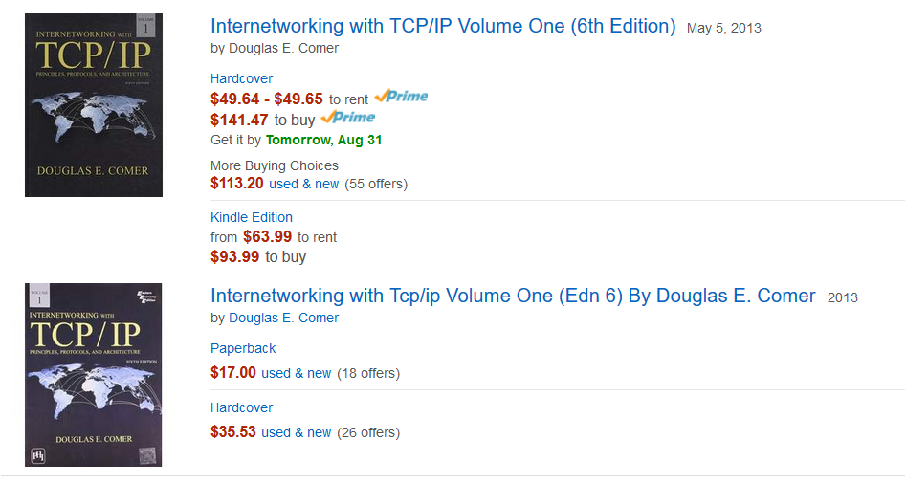
The Text

Slide 8
Contacting the Professor
Use email; send to
    dave@webmarketingadvantage.com
Call at home
    301 983-0452
Call cell—emergencies only
    240 305-8514

Slide 9
Internet background

Slide 10
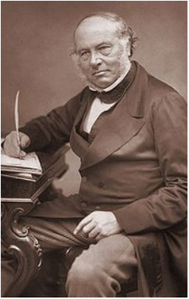
An Early Internet
Invented by Rowland Hill, English teacher, 170 years ago
Proposed having sender pay for postage, based on weight, to anywhere
More than 68 million Penny Black stamps were printed
Letters could now be sent anywhere in the world at low cost
Caused a revolution in communication

Slide 11
Internet Background
Computers are valuable
  Store, access, manipulate information
Networked computers are more valuable
  Computers cooperate
  Enables interaction, communication
All computers on one network changes everything
  Power of computers everywhere
  The right information everywhere
Metcalfe’s Law: The value of a network is proportional to the square of the number of computers connected to it

Slide 12
Key Internet Characteristics
Internetworking—interconnecting heterogeneous networks using a set of communications conventions that allows them to interoperate
Openness—publicly available specifications

Slide 13
What is the Internet?
It’s a network of networks
Computers are typically connected to some local area network, most often based on Ethernet
Local area networks are connected to one another by the Internet
This is called Internetworking

Slide 14
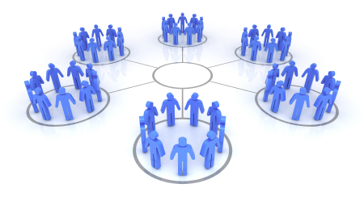
A Network of Networks

Slide 15
Openness
Internet standards are developed by open committees of volunteers
An RFC (“Request for Comments”) is issued, comments are collected, revisions made, and the standard is eventually adopted
Standards are independent of hardware and software
All vendors are free to implement the standards

Slide 16
Internet Services
Protocols—syntactical and semantic rules for communication
  Message formats
  Actions
  Error handling
  Hides details
Why hide the details?
  Create new programs quickly
  Replace computers without changing networks
  Same software version for all networks

Slide 17
Application-Level Internet Services
World Wide Web—documents connected by hyperlinks
Electronic mail—compose a note, send to individuals or groups; read a note that has arrived; can include files as attachments.
File transfer—send or receive file of any size.
Remote login—user at one machine can establish interactive session at another machine.

Slide 18
Network-level Internet Services
Connectionless packet delivery service—TCP/IP network routes small messages (packets) from one computer to another based on information in the packet. Not reliable.
Reliable stream transport service—app on one machine establishes “connection” to app on another machine, send data across the connection

Slide 19
Distinguishing Internet Features
Network Technology Independence—TCP/IP is independent of type of hardware and software
Universal Interconnection—any pair of computers attached to the Internet can communicate
End-to-End Acknowledgements—acks between source and destination, even if on different networks
Application protocols—programmers often find that Internet protocols offer just the services that they need

Slide 20

Internet Growth Trends

Slide 21
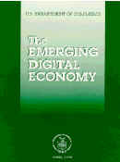
Statistics from the IITF Report
The Emerging Digital Economy *
To get a market of 50 Million People Participating:
    Radio took 38 years
    TV took 13 years
    Once it was open to the General Public, The Internet made to the 50 million person audience mark in just 4 years!!!
http://www.ecommerce.gov/emerging.htm
  Released on April 15, 1998
* Delivered to the President and the U.S. Public on April 15, 1998 by Bill Daley,
Secretary of Commerce and Chairman of the Information Infrastructure Task Force

Slide 22
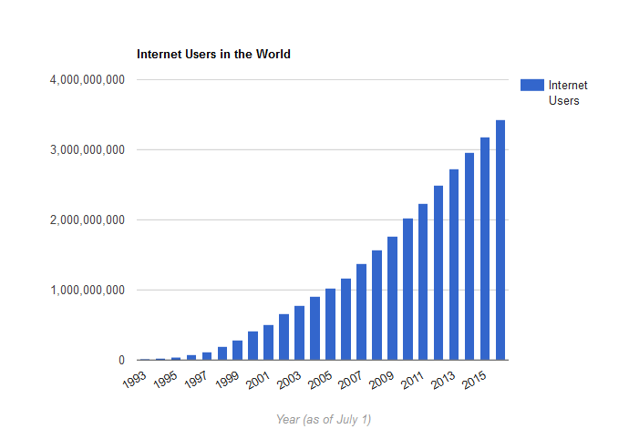
Internet Users in the World
Source: Internet Live Stats

Slide 23
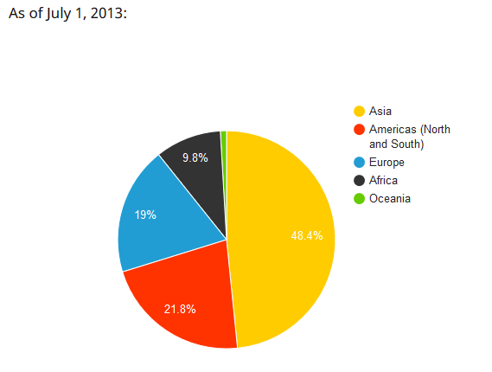
Internet Users by Region
Source: Internet Live Stats

Slide 24
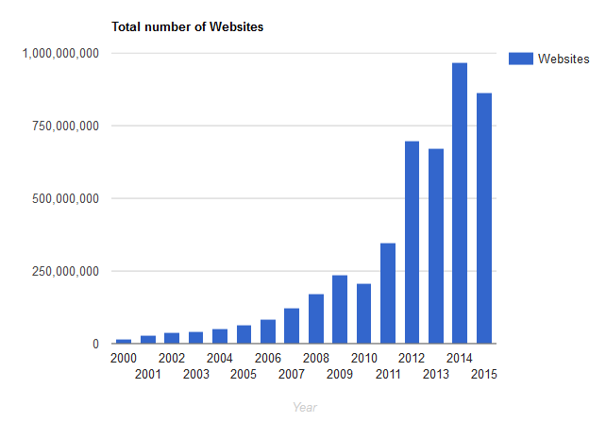
Number of Web Sites
Source: Internet Live Stats

Slide 25
Properties of the Internet
Universal addressing—All computers share a universal set of addresses
Network independence—methods to transfer data are independent of network technology, destination computer

Slide 26
Networking Concepts

Slide 27
Smart vs Stupid Networks
Smart network:
  Network has all the intelligence built in
  End point devices can be “stupid”, very simple
  Example: POTS
Stupid network:
  Network moves information and nothing else
  End point devices must be smart, must provide all services other than transmission

Slide 28
Smart Networks
Good about smart networks:
  Typically very simple end-point devices
  End-point devices easy to operate
  Maintenance of end-point devices not a problem
  Inexpensive end-point devices
Less good about smart networks:
  Hard to introduce a new service
  Expensive and hard to maintain

Slide 29
Stupid Networks
Good about stupid networks:
  Network itself is simple to build, maintain
  Introduction of new services doesn’t involve the network at all, very easy
Less good about stupid networks:
  Expensive end-point devices
  Maintenance of end-point devices more complex
  Use of end-point devices more complex

Slide 30
Questions
Is the Internet a smart network or a stupid network?
Where is the central control for Internet operations?
Give some examples of smart and stupid networks.
Which is better, smart networks or stupid networks?

Slide 31
Packet Switching
Connection-oriented (aka circuit-switched)
  Forms dedicated connection
  Guaranteed, dedicated capacity
  High cost
  Telephones work this way
Connectionless (aka packet-switched)
  Packets multiplexed onto high-speed connection
  Network hardware delivers packets
  Software reassembles them
  Traffic can slow things down
  Lower cost
  Internet works this way

Slide 32
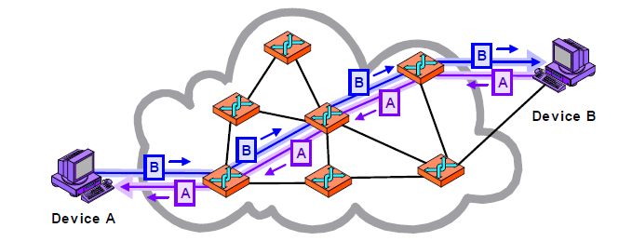
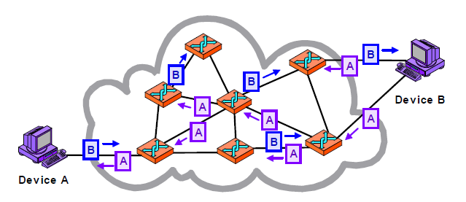
Circuit and Packet Switching
Circuit Switching
Packet Switching

Slide 33
Why Packet Switching
Efficient—maps directly onto hardware
Separates data from applications
Intermediate computers don’t have to understand or run the application
Flexible—networks are general-purpose
Change network without changing applications

Slide 34
WAN, LAN
Wide-area network (WAN)
  Communication over long distances
  Technology does not limit distance
  Tend to include intelligence
  Speeds to 155 Mbps
  Delays typically msecs to tenths of seconds
Local area network (LAN)
  Small geographic area
  Speed 10 Mbps to 2 Gbps
  Technology typically limits distance
  Delays tenths of msec to 10 msec
  Tend to not include intelligence

Slide 35
Ethernet, a LAN protocol
Local area network protocol, now evolving to WAN use
  Used to connect local computers
  Original implementation is distance-limited
Components
  Transceiver—connects to ether, sends in ether, talks to host adapter
  Host adapter—plugs into computer, connects to transceiver, controls transceiver

Slide 36
Alohanet—Internet Precursor
1971, connected University of Hawaii campuses on multiple islands
Common medium for all communication
Radio network used packet switching
Protocol:
  If you have data to send, send the data
  If while transmitting you receive data from another station, stop and resend later

Slide 37
Ethernet—Alohanet on Wire
Ethernet adopted the Alohanet protocol, used wire instead of radio transmission
Coaxial cable was the “ether”, the shared medium used by all stations

Slide 38
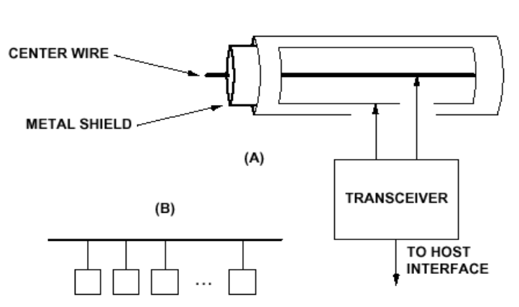
Ethernet

Slide 39
Ethernet Properties
Shared bus—all stations receive every transmission. Hub passes all packets to every host interface
Best-effort delivery mechanism—hardware provides no information to sender about whether packet is delivered
CSMA/CD—carrier sense multiple access with collision detection

Slide 40
Question
Who tells devices when to transmit on an Ethernet, so that they don’t all transmit at once?
No one! Each, on its own, does its best to find a time when no one else is transmitting.
If there is a problem, then each works on its own to fix the problem.

Slide 41
Collision Handling
When a collision is detected, the transceiver that detects the collision generates a random number and then waits that length of time before trying again
If the second attempt fails, it does the same thing but multiplies the number by two
This continues until a successful transmission takes place, with the wait intervals doubling with each failure

Slide 42
Ethernet Hardware Addresses
Unique 48-bit number for every network adapter, called the MAC address
Address is fixed into each transceiver when it is manufactured
Types:
  Broadcast—all 1’s
  Multicast—subset of net; NIC looks for address
  Unicast—to single network interface

Slide 43
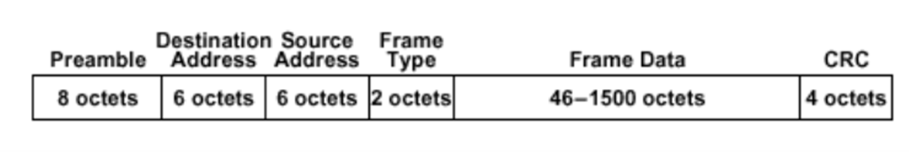
Ethernet Frame
This is what is sent between computers on a local area network using Ethernet

Slide 44
Interconnecting Ethernets
Each Ethernet is distance-limited
How can we interconnect multiple Ethernets?

Slide 45
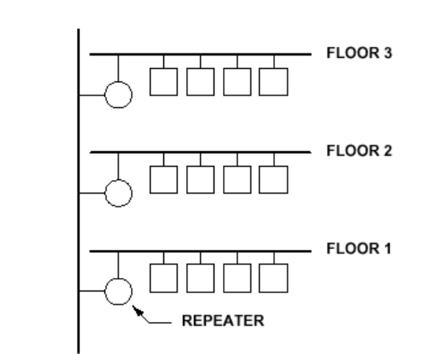
Repeaters
“Stupidest” approach
Copy electrical signals both ways. Max of 2 levels of repeaters between any pair of computers:

Slide 46
Repeaters
What’s good:
  Simple device
  Extends length
What’s less good:
  Messages not intended for a floor are transmitted on that floor anyway
  Repeaters greatly increase traffic
  Copies noise, garbled messages

Slide 47
Bridges
Smarter than repeaters
Receive frame from one network segment
Understands what a frame is
Transmits valid frame on another segment
Doesn’t replicate noise, bad packets, etc.

Slide 48
Bridges
What’s good
  Noise and bad messages aren’t copied to other networks
What’s less good
  More costly
  Message not intended for anyone on a network will be copied to that network
  More bridges cause more traffic to every network on the bridge

Slide 49
Adaptive Bridge
Smarter still
Consists of computer, 2 network interfaces (NICs)
If bridge gets packet from one network segment, it makes note of sender address
Eventually, adaptive bridge knows all addresses on each network segment it connects to, knows whether to forward a packet or not
Forwards only packets intended for another network segment

Slide 50
Adaptive Bridge
What’s good:
  Noise, garbled messages are not copied to other networks
  Message not intended for anyone on a network isn’t place on that networks
What’s less good:
  More complex, expensive
  Won’t work well if network configuration is constantly changing

Slide 51
Routers
A computer, at least two NICs
Router interconnects multiple LANs
Routers learn how to reach destinations on many LANs, even those they do not connect to directly
Routers work cooperatively to forward messages across many networks to reach a destination on another network

Slide 52
What’s good
  Routers enable the Internet
  Messages can go anywhere in the world
What’s less good
  Complex protocols are needed so that routers keep up-to-date and can route messages anywhere in the world
  Whole Internet depends on routers
  Router time is the most critical resource on the Internet

Slide 53
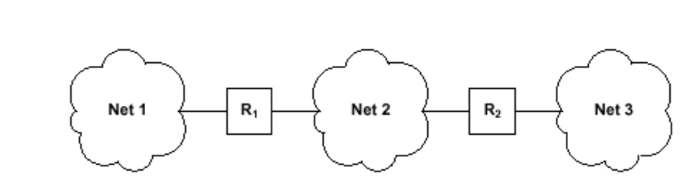
Routers
Networks interconnect through routers
IP routers provide interconnection between physical networks
Information stored by routers is based on number of networks interconnected, not number of computers connected

Slide 54
Review
Introduced notion of the Internet
Talked about network types that make up the Internet
Discussed Internet services
Previewed technologies that we will discuss this semester

