Slide 1
CSCI 233 Internet Protocols Class 6
Dave Roberts

Slide 2
Key Principles
Good citizen principle
Conserve router time
End-to-end operation

Slide 3
Agenda
Routing Architecture
Cores, peers and algorithms
Autonomous Systems
Routing between autonomous systems

Slide 4
Origin of Routing Tables
Routers interconnect networks
Datagram travels from router to router until it reaches a router attached to the same network as the final destination—then it gets delivered using the local network
Routing table has network id, address of next machine for that network id
How does the routing table get its information?
How is the routing table maintained?
Does the routing table have the MAC address or the IP address of the next machine?

Slide 5
Routers and Hosts
Host may have only 2 routes
Route for local network
Default route to local router
Interstate road sign analogy—successive signs on 270 headed south toward Potomac
Right to Gaithersburg
Right to Rockville
Right to Potomac
Interstate road signs don’t list all destinations
Still give complete directions
Signs analogous to routing tables

Slide 6
Road Analogy
Possible configurations:
Star configuration of roads, single central intersection—say, at town square. Signs at square must show routes to all destinations.
Roads a richly connected network, signs at every intersection to all destinations.
Two towns, separated by bridge over river. Neither trusts the other, so signs on West for destinations on Western side, signs on East for destinations on Eastern side of river
Notes:
Star configuration won’t work because of the requirement for a centralized switch, with capacity requirements that would make it the largest machine in the system, growing literally without limit.
Richly connected network won’t do, because there are too many street signs to maintain correctly.
Third approach is the real analogy to the Internet. Router is the bridge, router table just says “if it’s on the other side, cross the bridge.”

Slide 7
Cores
Original Internet architecture
Use central core routers with complete information, outer routers with partial information
Job of local administrators is simplified
Potential for inconsistency, which can make some outlying destinations unreachable

Slide 8
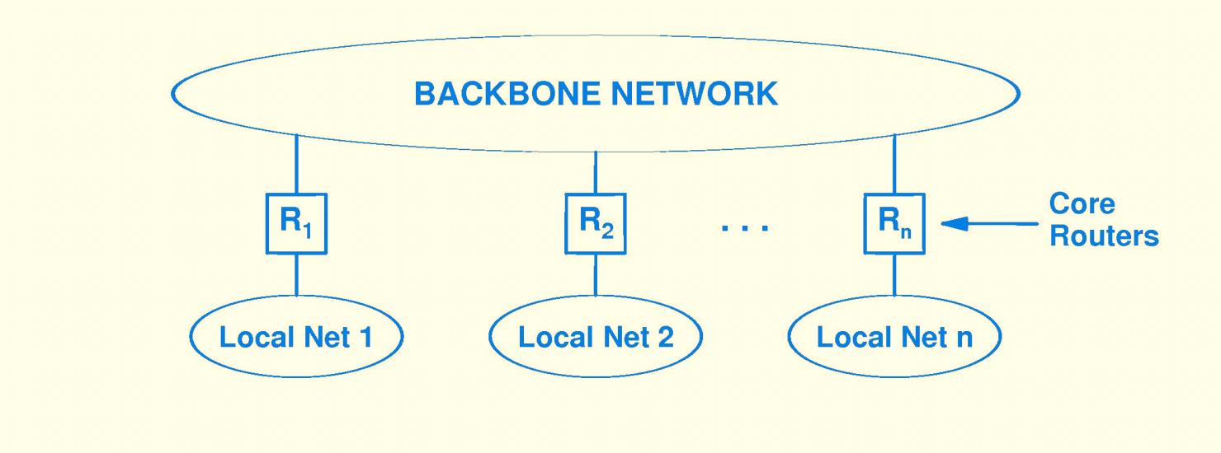
Core Routers
Early Internet used Arpanet as backbone. Every site had to advertise Internet addresses
All nonlocal traffic was passed to the closest core router.

Slide 9
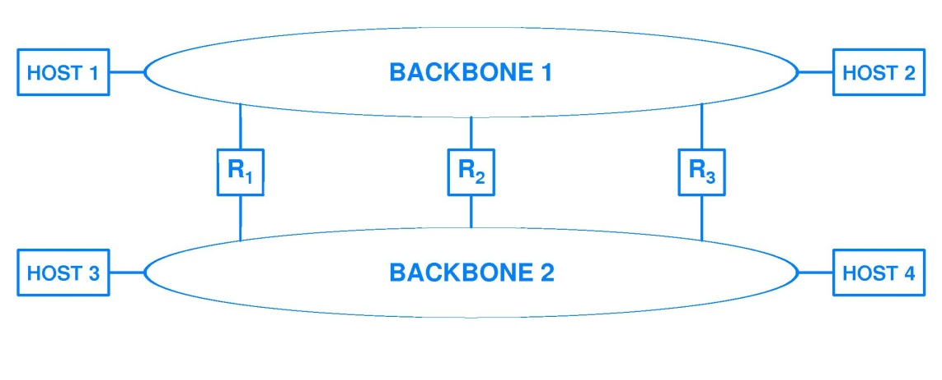
Core Router Problem
This approach doesn’t work if core routers have incomplete information. If destination is unknown, default route is to core router. Then core router default path can pass through all other routers if core router doesn’t know the route to it .
Potential for large number of router hops for a datagram that takes the default path.

Slide 10
Core Router Problem…Solved
Core routers exchanged routing information so that each had complete information about optimal routes to all destinations
What’s wrong with this picture:
Internet outgrew any possible central backbone
Not every site had could have a core router
Core router interaction limits ultimate scalability
Notes:
Q--What would core router do if it did not have a destination to the specified destination address for a datagram?
A—Send ICMP message. Which ICMP message? Destination unreachable.

Slide 11
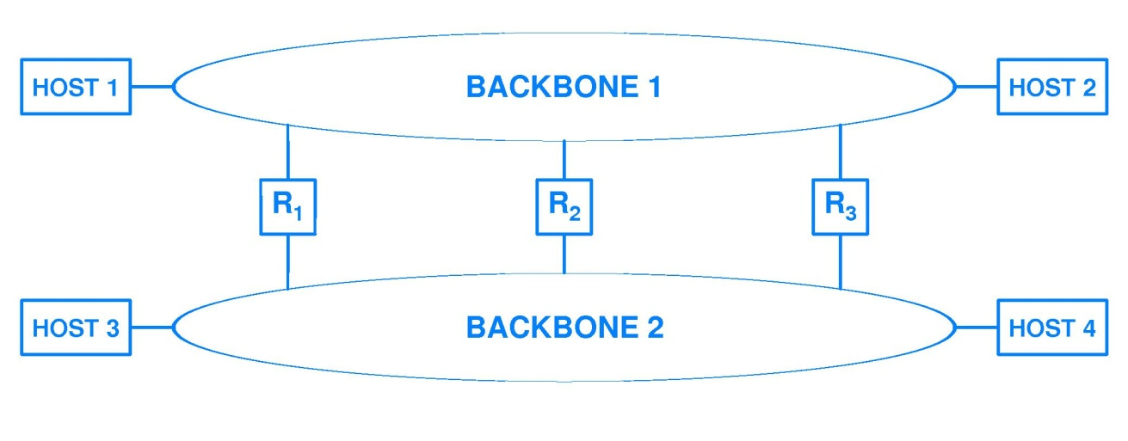
Peer Backbones—More Complexity
NFSNet backbone, when it became a peer backbone, introduced more complexity.
Very complex for core routers to know optimal routes to all hosts. Easy for illegal address to cause router loop.
Notes:
If hosts on left are on west coast, hosts on right are on east, how to route from 1 to 4? Go over Arpanet backbone to R3 then to NSFNet backbone to host 4? Or take R1 to NSFNet backbone, then NSFNet backbone to host 4? Answer depends on capacity and utilization of routers, networks.
For peer networks, routing tables need different routes for different hosts, cannot route all datagrams for hosts on another network through the same router.
If routes are not consistent between the two backbones, then it’s possible for routing loops to develop between peer networks.
Q—what will happen to a datagram that is caught in a router loop?
A—it will circulate until its hop count goes to zero, then be discarded and an ICMP message sent to the sending host. Which one? Timeout.

Slide 12
Today’s Internet
Each ISP operates as an autonomous system
ISPs meet at Internet Exchange Points, where they have peering agreements, connect directly
Traffic is exchanged without fee at IXP
IXPs have switches, ISPs run BGP through switches and through direct connections
More about autonomous systems later

Slide 13
Today’s Internet
ISP
ISP
IXP
IXP
ISP

Slide 14
Now on to routing…

Slide 15
Automatic Route Propagation
Two separate protocols operate in routers
Forwarding protocols—IP datagrams arrive, are forwarded
Routing protocols—route information is shared with other routers
Routing protocols
Compute shortest paths
Respond to topology changes by updating shortest paths
Routing protocol software
Runs independently of IP software, maintains FIB
Occasionally updates forwarding tables used by IP

Slide 16
Routing Algorithms
There are many (many many) variations on routing algorithms
They all fall into two categories:
Distance-vector
Link-State
Distance-vector
Each router builds a list of destination networks and the next hop to reach destination in shortest number of hops
Routers know nothing about network topology
Link-State
Each router builds a map of the network topology
Each router computes shortest path to each network
Why do you think each class of algorithm has the name that it does?

Slide 17
Exchanging Route Information
How can routers exchange route information to keep routes up-to-date?
Distance-vector (aka Bellman-Ford): routes are selected based on the distance between networks. Distance metric is something simple such as number of hops (routers) between them. Each router maintains a table of all networks in the internetwork and the number of hops to each.
Shortest path first (aka link-state): selects routes based on a dynamic assessment of the shortest path between them. Each router maintains a map of the current topology of the network.

Slide 18
Bellman-Ford Routing (Distance Vector)
Router keeps a list of destination networks, distance to each
Router sends copy of its router table to each router it reaches directly
The router table is a vector of distances
Notes:
Figure shows initial router table. Router connects directly to two networks, each has distance zero.

Slide 19
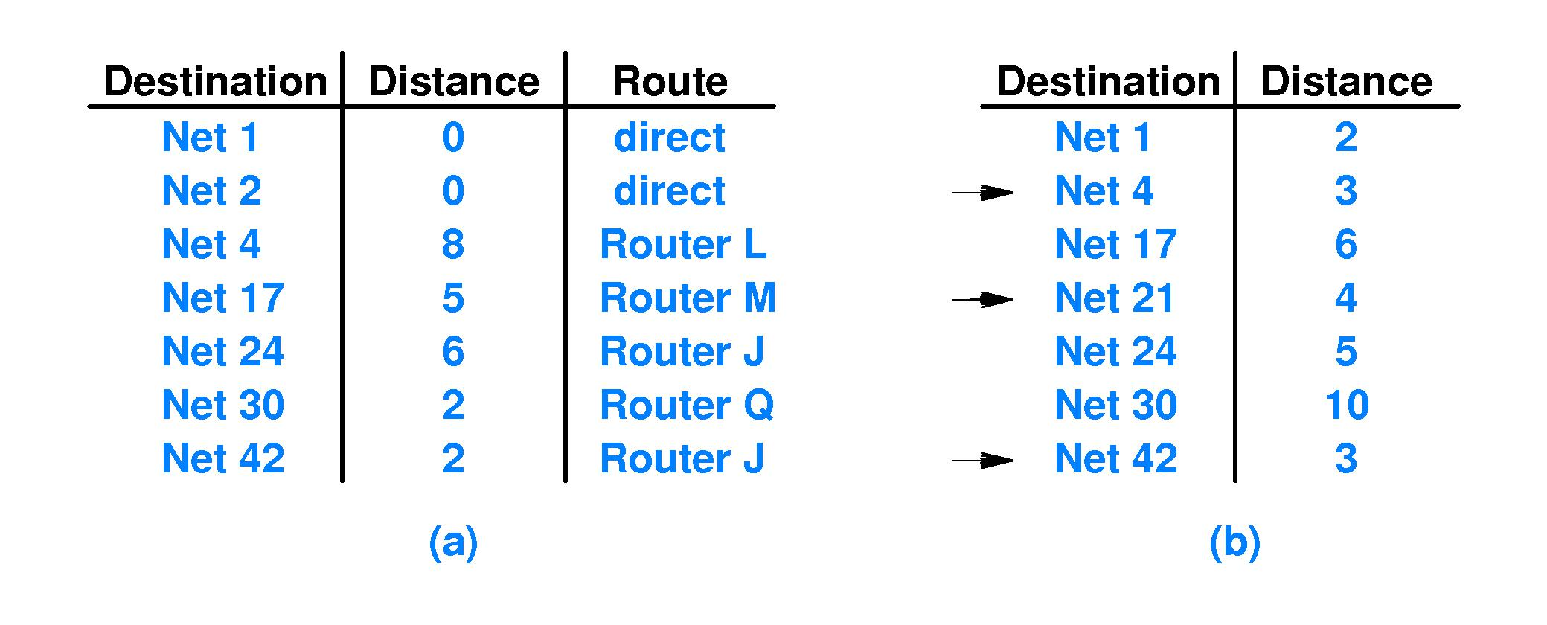
Updates
Router Table in Router K
Router J Update Message
Marked entries cause changes to router table.
Notes:
This shows three cases of what happens when a new router table arrives.
Net 4: new table shows shorter route. Adopt new route.
Net 21: new table shows how to get to net 21, didn’t know how to get there. Add it.
Net 42: new table shows longer route to net 42, don’t adopt this new route
In a static environment, distance vector algorithm works well; but if routing information changes rapidly, propagation time of this method is too slow. Routes may never settle down, and some routers may have incorrect information.

Slide 20
Disadvantages of Distance-Vector
Propagates slowly
Can take multiple cycles for changes to propagate
Messages exchanged tend to be large
Distributed computation of routes may not converge in presence of frequent changes
Doesn’t scale well

Slide 21
Link-State (SPF) Routing
Called Shortest Path First—SPF
Each router table shows full network topology
All routers
Networks they connect to
Each router tests its neighbors
Sends test message
Propagates status of its neighbors
Router receiving message adjusts its topology table, uses Dijkstra shortest path algorithm to compute shortest path to each network

Slide 22
Advantages of Link-State
Much less information is propagated
Scales better than distance-vector
Easy to identify and solve problems because of simplicity of information exchange
Each router computes its own routes, not dependent on possibly incomplete propagation of change information

Slide 23
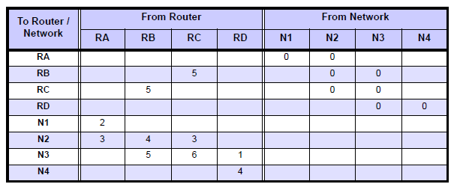
Link-State Example

Slide 24
Heuristic Guideline
Up to 12 routers can participate in a single routing information protocol across a WAN
Up to 60 routers can participate in a single routing information protocol across a set of local LANs

Slide 25
Autonomous Systems

Slide 26
Autonomous Systems
Each organization’s networks are considered an autonomous system
Organization is required to keep router tables consistent, correct, in any way they please
One router from the AS is chosen as the router that will inform the outside world of routing within the AS
Notes:
Note that original Internet core routers formed an autonomous system.

Slide 27
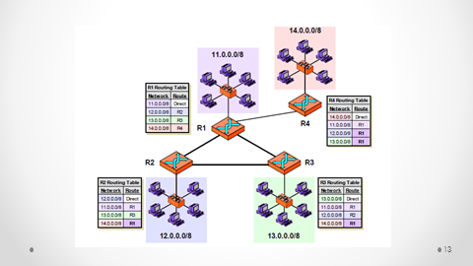
Independent Autonomous Systems

Slide 28
Border Gateway Protocol
ASs that exchange router information designate a router that will exchange information through BGP.
BGP machine is generally near the “edge” of the AS, called a border gateway or border router.
Notes:
Current version is BGP-4.
In the figure, R1 and R2 are each gathering information about their networks and using BGP to send that information to the other.

Slide 29
BGP
BGP shares next-hop information about the path from itself to another network
This is shared with all external peers
Also shared with internal peers
BGP does not share information about interior of its AS with other ASes

Slide 30
BGP
Coordinates among multiple BGP speakers
Allows autonomous systems to communicate
Propagation of reachability information
Supplies next hop for each destination
Implements local policy decisions
Reliable transport (i.e., uses TCP)
Advertises path information to destinations
Incremental updates
CIDR address support
Authentication

Slide 31
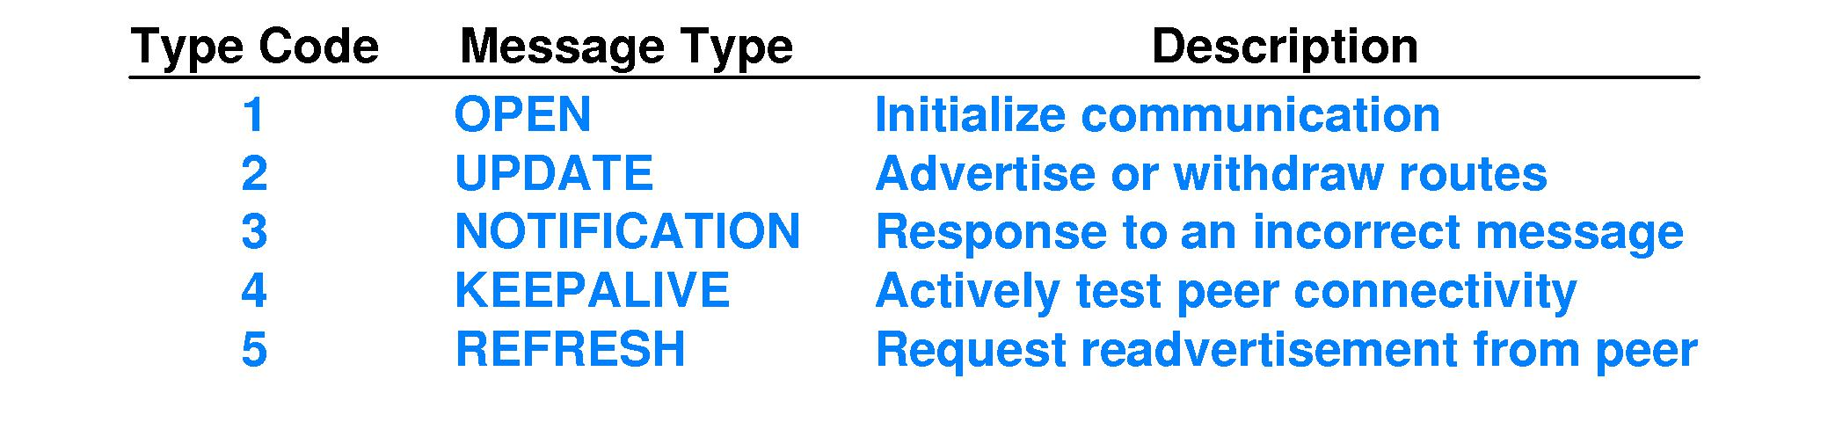
BGP Message Types

Slide 32
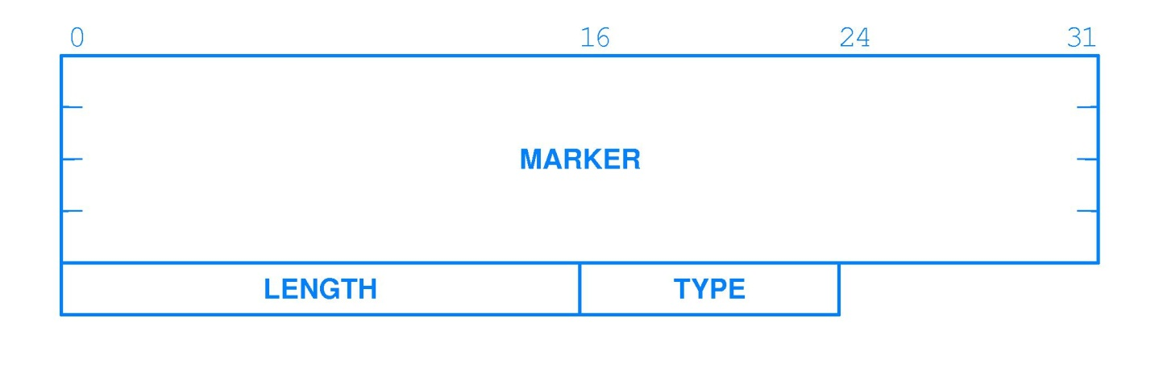
BGP Message Header
Why does the header have a marker? What is its content?
Notes:
Marker is agreed by both sides to mark the start of a message. All 1s in first message, later can contain authentication information. Contents must be agreed so that it can be used for synchronization.
LENGTH is the total message length, in octets.

Slide 33
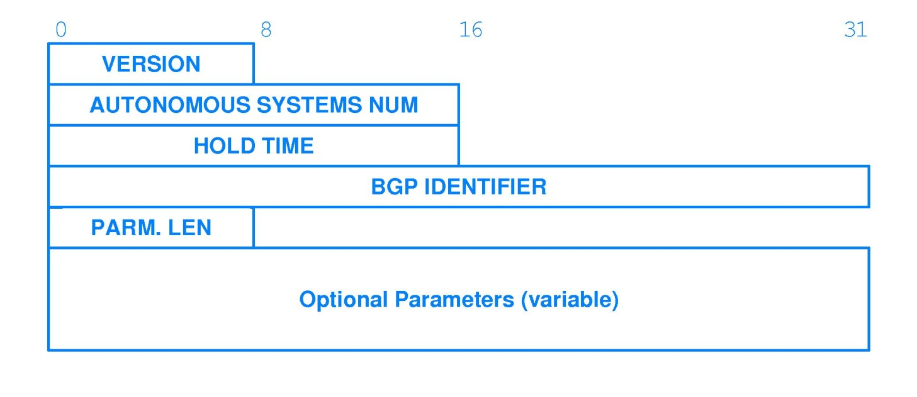
BGP Open
Notes:
Two BGP peers each send OPEN message to declare AS number and establish other parameters. HOLD TIME is max time that can elapse between receipt of two successive messages. Version is protocol format, this is for version 4.
BGP identifier is IP address of sender.
Hold time is how long to wait between messages. Receiver is required to establish timer set at this value.

Slide 34
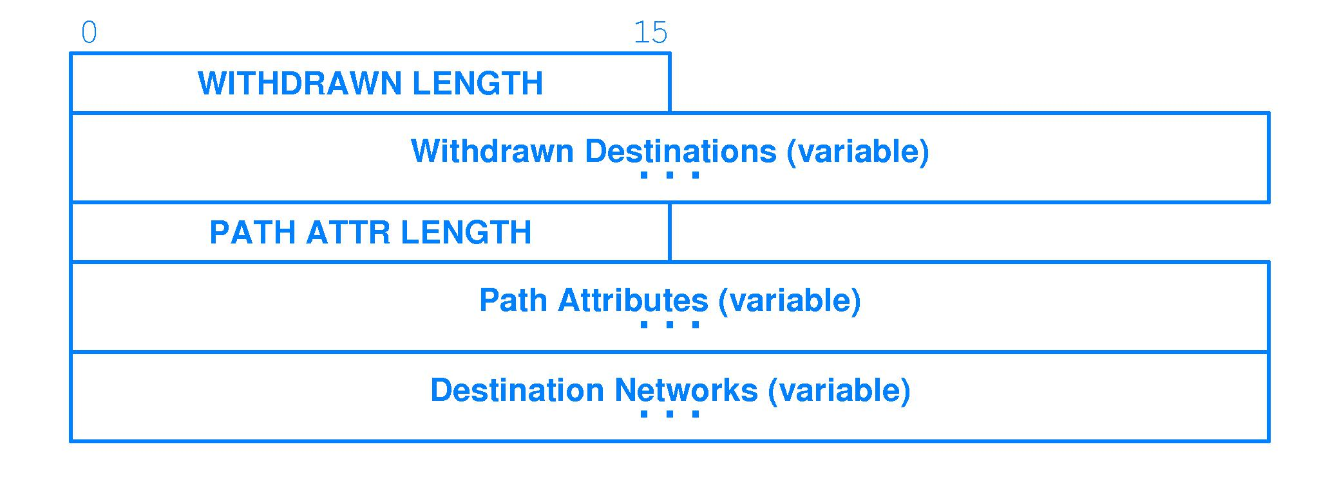
BGP Update Message
Notes:
Previously advertised destinations are withdrawn, and new destinations are advertised.

Slide 35
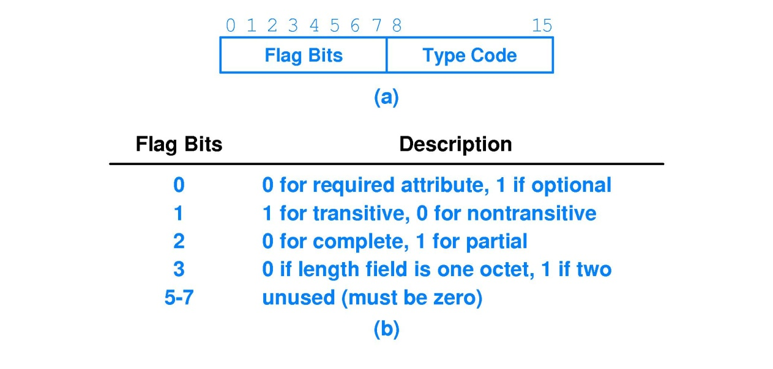
Path Information
Notes:
Not going to say much about this, except to note in passing that path information is provided. Can give path through several autonomous systems.

Slide 36
BGP Reporting
R₂ gives next-hop information to peers on behalf of the network
Notes:
R1 is designated to speak BGP on behalf of he AS. It must report Net 1 as reachable through R1, and so on—reporting information from the perspective of the outsider, not a system inside the network.

Slide 37
BGP Notification Message
BGP sends notification message, then closes TCP/IP connection
Notes:
Errors are permanent—once detected, BGP sends notification, closes TCP connection.

Slide 38
BGP Restriction
BGP does not advertise path lengths inside its AS
Because of this, BGP cannot choose shortest path
BGP is used to advertise only destinations that traffic can reach.

Slide 39
Internet Routing Registry
Many registries exist
Shows which ISPs own which addresses
Allows validation that ISP advertising connectivity actually has that IP address
No centralized, authenticated registry
Routing problems exist
Notes:
So ISP advertises reachability to route server using BGP. Good feature of BGP is ability to convey negative information, so that entries are dropped from tables.

Slide 40
Summary
Must partition routers into groups, or information exchange would be burdensome
BGP is most used External Gateway Protocol
Each ISP is a separate AS, boundary at NAPs, where multiple ISPs interconnect

Slide 41
Routing Within an AS
RIP
OSPF
HELLO

Slide 42
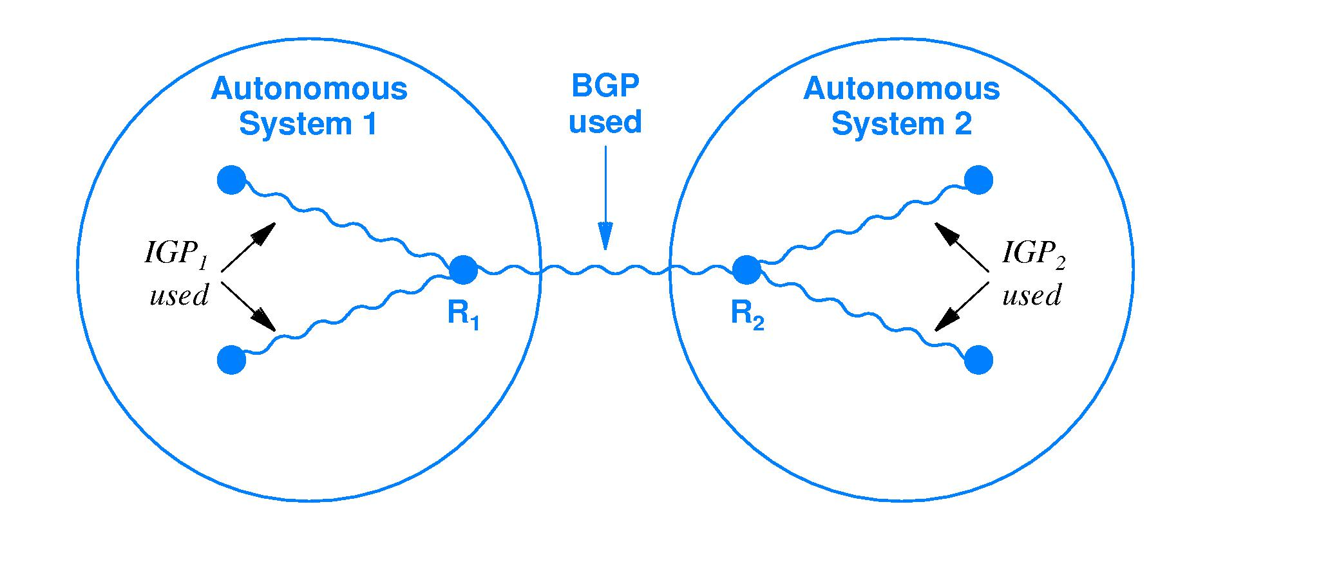
IGP—Interior Gateway Protocol
Two ASs using their own IGPs internally, BGP between one another
Notes:
A single router can use two different protocols simultaneously, one to communicate outside its AS and another to communicate within its AS.

Slide 43
RIP—Routing Information Protocol
Routed—program that implements RIP
Participants are active and passive
Active: advertise their routes to others
Passive: listen to RIP messages, update router tables, but do not advertise
Update broadcast every 30 seconds
Update is pairs—network address, number of hops to it
Existing routes are kept until new route has lower cost
RIP routes time out in 180 seconds, are deleted
Notes:
Q—does hop count allow for selection of optimal route in all cases?
A—No! Does not allow for difference of time on different networks
Final rule introduces hysteresis, prevents oscillation

Slide 44
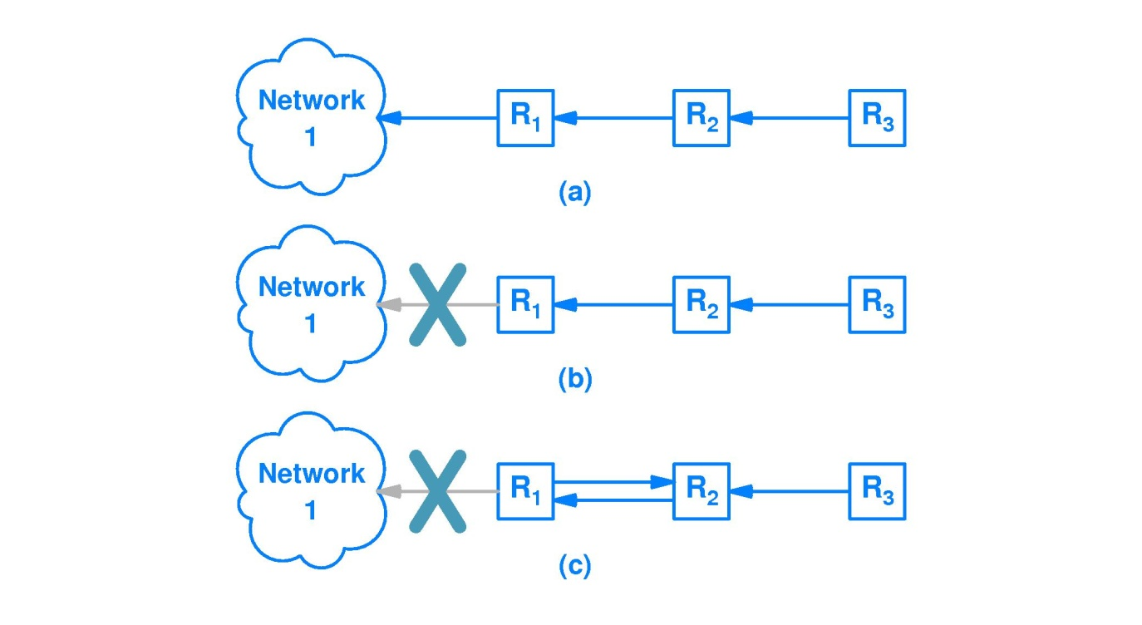
Slow Convergence Problem
Notes:
In a, there is a connection to network 1. R2, R3 have learned the route to Network 1 from R1.
In b, that connection quits working or is disconnected; but R2 causes a routing loop by continuing to advertise it.
Now R1 will pick up R2’s advertised route to network 1. So packets from R3 to network 1 will come to R2 and then loop with R1, until hop count reaches zero.
Two routers can continue this forever.

Slide 45
Solving the Slow Convergence Problem
Split horizon update—router does not propagate information about a route back over the same interface from which the route arrived
In example, R₂ would not advertise a route to net 1 back to R₁.
Hold down—routers ignore all information about a network for some hold down period after sending a destination unreachable message
Poison reverse—router immediately advertises infinite cost to reach removed connection
Notes:
Broadcasting is very costly—RIP is inefficient.

Slide 46
RIP1 Message Format

Slide 47
Disadvantage of RIP Hop Counts
Low value for infinity restricts size of any internet using RIP
Restricts routing to hop-count metric; hop count may be poor predictor of delivery time
Routing becomes relatively static, unable to respond to changes in load

Slide 48
HELLO
An IGP using a routing metric other than hop count (now obsolete)
HELLO
Synchronizes clocks
Allows each machine to compute shortest delay paths to destination
Allows machines to compute routes based on time

Slide 49
Problems with Hello
Instability—protocols that change routes quickly can be unstable
Hold down is commonly used to increase stability
Time measurements are rounded

Slide 50
Open SPF Routing
Interior gateway protocol using link state algorithm
Open, can be implemented at no cost
Includes type of service routing
Provides load balancing
Network partitioned into areas, separate from each other
Authentication for all router info exchanges
Notes:
SPF—shortest path first

Slide 51
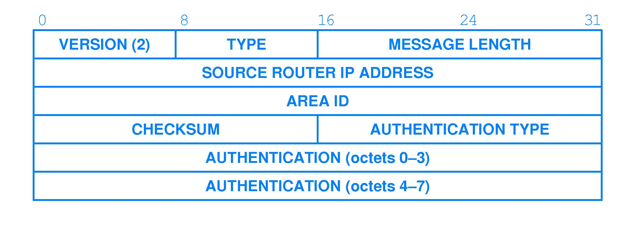
OSPF Message Format
Notes:
Version
1 hello (test of reachability)
2 database description (topology)
3 link status request
4 link status update
5 link status acknowledgement

Slide 52
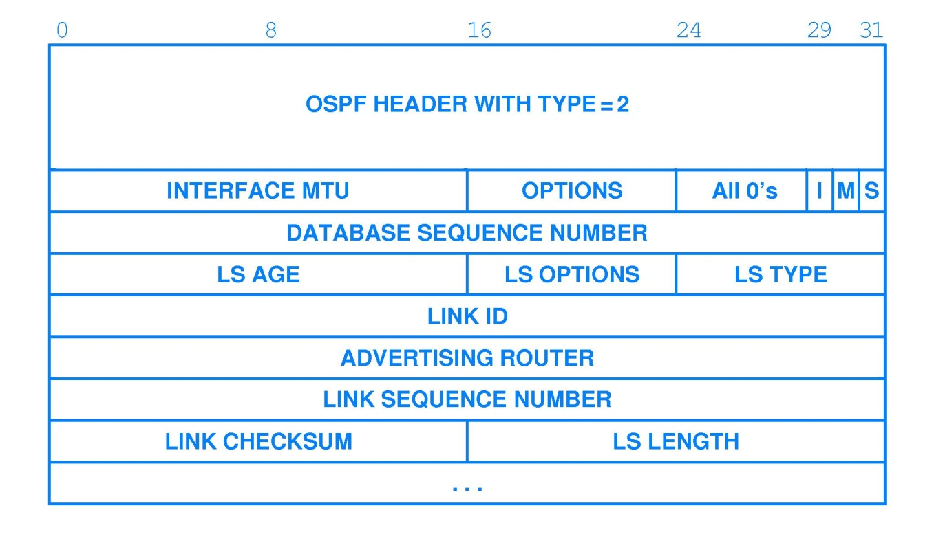
OSPF Database Description Message
Notes:
Link type
1 router link
2 network link
3 summary link (IP network)
4 summary link (link to border router)
5 external link (link to another site)

Slide 53
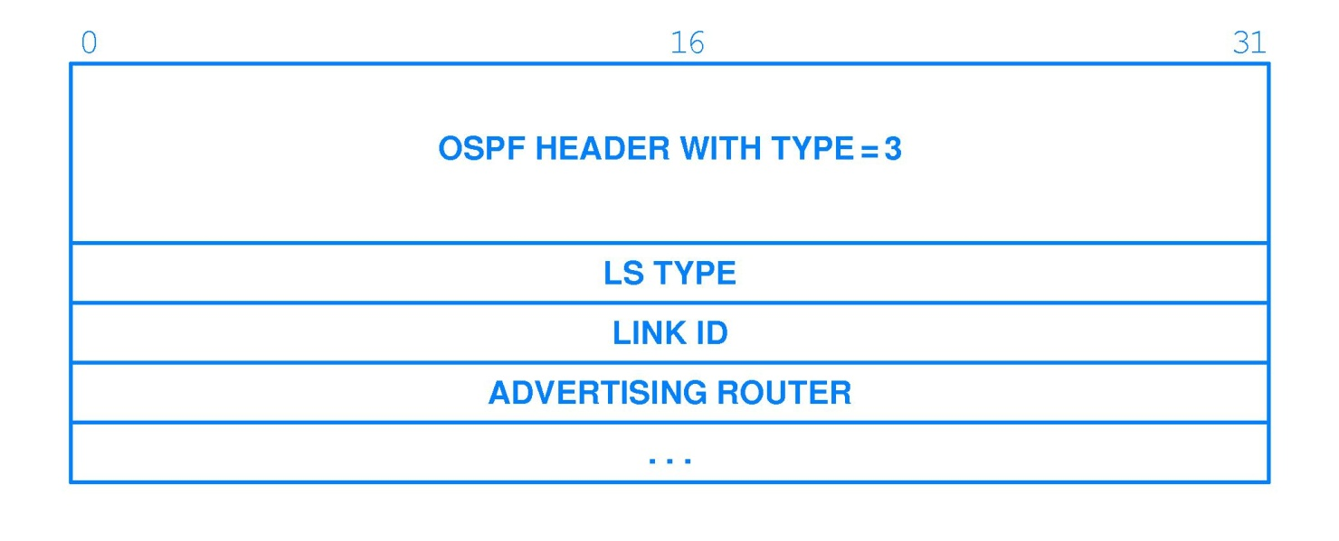
OSPF Link-Status Request Message

Slide 54
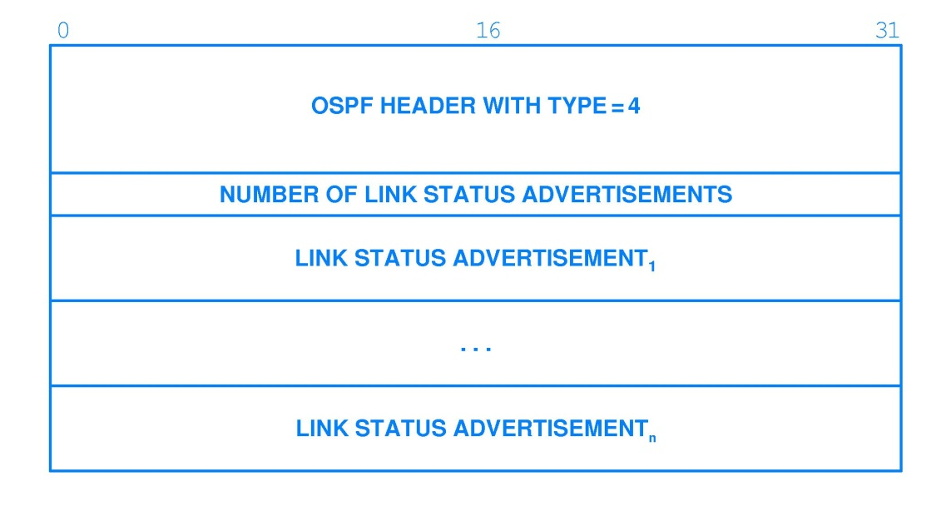
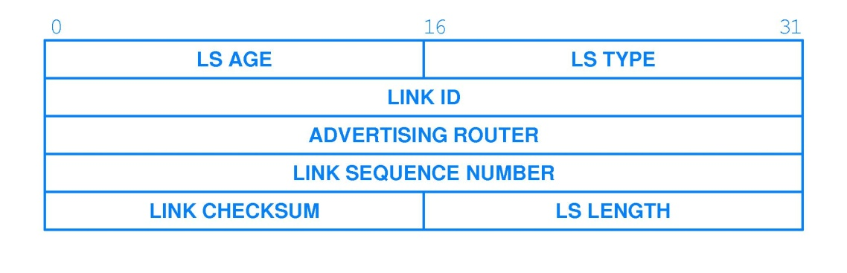
OSPF Link-Status Update Message

Slide 55
Summary
Manual maintenance of router tables is not practical for larger networks
An IGP (Interior Gateway Protocol) allows routers to exchange information
IGP implements either distance-vector or link state algorithm (SPF)

