Slide 1
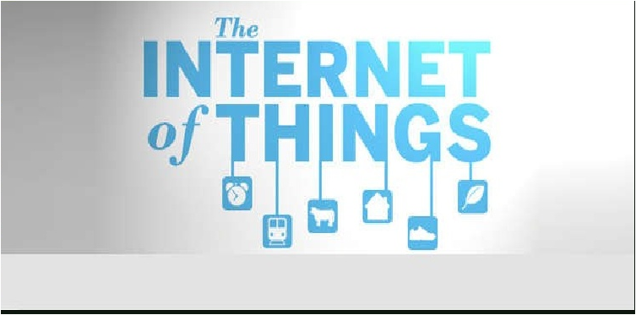
Copyright 2016, David C. Roberts, all rights reserved

Slide 2
The Internet of Things
It’s happening!
Web 2.0 has emerged and happened
We will find ourselves surrounded by things that are all trackable, connected to the Internet
Many of these things will also interact over the Internet
We will find our car keys by a simple Google search

Slide 3
Evolution of the Web
Web 1.0
Web as information distribution, access
Content developed by providers, accessed by the masses
Impact: disintermediation
Examples: CD stores vanish, travel agent business hollowed out
Web 2.0
Collaboration by the masses in developing content
Increased impact from Web participants
Impact: direct power of self-organized feedback
Examples: decline of newspapers, rise of blogs, impact of Facebook on businesses, Wikipedia
The Internet of Things
Everyday objects are Internet hosts
Great impact on everyday life
Impact: new abilities to understand and control our surroundings
Examples: self-driving cars, new medical diagnosis, new levels of retail automation

Slide 4
Consequences
Think of all objects tagged with RFID tags
All objects of daily life known by computers
Life on Earth would change
Companies never run out of stock or waste products in production
Mislaid or stolen items are all found immediately
Sensors and actuators embedded in physical objects are linked through wired and wireless connections
Objects can sense the environment and communicate

Slide 5
Addressability of things
Can make all things accessible through present naming protocols, through URI
Objects may converse or may only be referred to
IPv6 has enough IP addresses to communicate with every object in the world
Computers are developing the power to track every object in the world
The Internet will provide the communication needed for this tracking

Slide 6
What’s a “Thing”?
“Thing” covers a wide variety of devices:
Heart monitoring implants
Biochip transponders on farm animals
Autos with built-in sensors
Robots for bomb disposal
Gadgets at home

Slide 7
Technology Roadmap

Slide 8
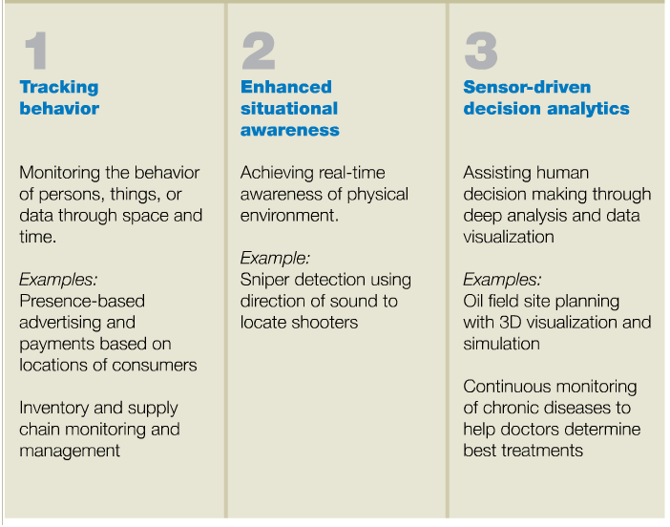
Information and Analysis

Slide 9
Information and Analysis
Tracking behavior
Products with sensors can be tracked and interacted with
Business models can be fine-tuned to use this information
Examples
Insurance companies offer to put location sensor into insured car, basing rates on actual driving measurements
Embed sensors in rental car, rent for short times to registered service users (Zipcar)
Makers of jet engines retain ownership of engines in planes, charge for hours used

Slide 10
Enhanced Situational Awareness
Heightened awareness
Large numbers of sensors in infrastructure or the environment report on conditions
Advanced display, visualization techniques used to show results
Examples:
Security personnel use sensor networks that combine video, audio, vibration detectors to spot intruders into restricted areas
Logistics managers for airlines, trucking lines get up-to-the-second knowledge of weather, traffic patterns, vehicle locations
Law officers get instantaneous data from sonic sensors to pinpoint location of gunfire

Slide 11
Sensor-Driven Decision Analytics
Support for more complex human planning and decision making
Tremendous storage and computing resources are required (and available)
Advanced software systems produce displays for analysis
Examples
Retail companies track behavior of shoppers inside stores, learn how long they pause where. Use this to drive simulations, redesign store layouts.
Patients with congestive heart failure are monitored continuously during daily activities, giving early warning to physicians
Extensive sensor networks in the soil can give more accurate readings of location, structure, dimensions of potential oil fields underground

Slide 12
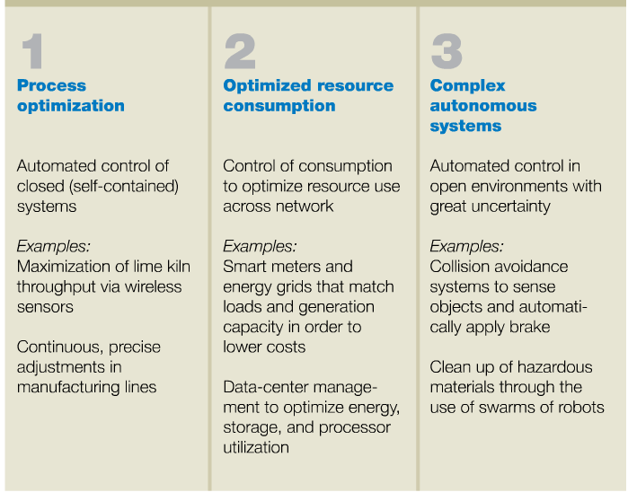
Automation and Control

Slide 13
Process Optimization
Internet of Things opens new frontiers for improving processes
Greater granularity of monitoring provided by legions of sensors
Computer analysis in real time used to control processes
Examples
Pulp and paper industry uses embedded temperature sensors to adjust flame shape, size in kilns to increase productivity
Sensors and activators can adjust position of an object as it moves down assembly line so that it meets machines at the correct orientation

Slide 14
Optimized Resource Consumption
Optimizing use of scarce resources
Networked sensors provide real-time consumption, demand data
Dynamic pricing can change demand patterns
Examples
Utilizes are deploying smart meters that enable time-of-use pricing
Data centers include server power sensors to enable shutdown of servers that are not being used

Slide 15
Complex Autonomous Systems
Machine decision-making that mimics human reactions
Real-time sensing of unpredictable conditions
Instantaneous responses driven guided by automated systems
Mimics human response but at vastly better performance levels
Examples
Experiments with automotive autopilot for networked vehicles at highway speeds
Tests of swarms of robots that maintain facilities or clean up toxic waste
Future systems to coordinate movements of groups of unmanned aircraft

Slide 16
A Few More Prosaic Examples
Shopping
Water management
Cities
Food tracking

Slide 17
Shopping
Each shelf knows its contents
Put an object into your cart and the cart tells you how much you’re spending
No cashier, the store collects automatically for what you’ve bought when you leave
People are stocking shelves and cleaning the store but that’s about it for people
Currently, Wal-Mart is requiring its clothing suppliers to put RFID tags on all clothing
They are reaching for this automation first in clothing and will achieve it in a few years

Slide 18
Water Management
Our large cities dump millions of gallons of sewage into rivers whenever there’s a big rain
If we track water flows and weather forecasts it’s possible to manage all of this and keep sewage out of rivers
Today only completely separate storm and sanitary systems permit that, at costs that can’t be afforded
A city becomes more like a living organism, temporarily storing water at various places

Slide 19
Cities
When municipal data is open, cities become “smart cities” because of applications that integrate this data
New York City opened up its data, has a contest for best new application
“Roadify” has locations of moving buses, subways, parking spot locations; it’s crowd-sourced
“Sportaneous” helps you get together a pick-up game in your sport of choice, finds venue and recruits players, notifies you when there are enough

Slide 20
Food Tracking
Each food item can have an edible printed RFID tag
We can track all food that we buy and everything we eat
We’ll know how many calories we’ve consumed and what nutrients, all the time
If we eat sushi we can know when the fish was caught and when the roll was made
We know exactly what nutrients to take based on what we have taken in

Slide 21
More Examples
GPS-driven farm equipment can change how it treats fields based on information from overhead sensors
More fertilizer in some areas
Deeper or shallow tilling as needed
Microcameras shaped like pills are swallowed
Relay thousands of images for diagnosis
Images are organized, displayed in real time
Smart billboards
Sense who is nearby, possibly looking at them
Choose content tailored to the people in the area

Slide 22
Issues
Privacy
Genuine threats to liberty
Commercial
Government
Security
It’s still the Internet
Designed for trusted participants
Not really suitable for public access
Employment
New capabilities will eliminate huge number of jobs
Examples: cashiers, inventory takers, many others

Slide 23
Privacy Issues
Today’s privacy issues become much more severe
Potential for exploitation by criminals and for government abuse
Today, cell phone companies sell information about locations of their cell phone subscribers
This is combined—today—with credit card purchase data to form very detailed profiles of our spending behavior
Targeting ads to us is innocuous enough
But we don’t want the burglar to know when we’re 150 miles from home
We don’t want the police to use our cell phone GPS to automatically give us a speeding ticket if we exceed the speed limit

Slide 24
Risks to Liberty
Real risks to liberty, not just from government
What if all insurance companies insist that you put their GPS sensor on your car?
What if every block on every street has a speeding ticket camera?
What if bill collectors can purchase real-time information about where you are, hound you 24 hours a day?

Slide 25
Surveillance
Surveillance of public places is growing
It has been shown to have great value for public safety
But we don’t today have enough limits on use of data
How much privacy should individuals have?
Is a camera in a public place producing data that should be public? Is it the same as a person standing outside looking around?
What happens when faces can be recognized? When license plates can be read automatically?
Today police cruisers carry automatic license plate readers, scan every plate that is passed, automatically
Easy to find a stolen car. Hard to avoid abuse if the police become overzealous.

Slide 26
Security
The Internet was designed to serve trusted participants
At the outset, all participants knew each other personally
Design didn’t need to consider someone trying to subvert the network or other hosts
Not suitable for public access
Accountability is missing in the Internet
Too easy to pretend to be someone else
Hard to find bad guys and penalize them
Huge resources are being wasted

Slide 27
Employment
Jobs where people are mostly entering information but not exercising judgment will increasingly disappear
Examples: store without cashiers or inventory clerks, toll road with no toll collectors (already here!), automatic checking of lift tickets at ski lift
New jobs for people who perform these functions won’t be available because they will be going away also
National vision and a plan about this problem is needed
It may be necessary to rethink employment
32-hour work week?
Job sharing?

Slide 28
Examples…from serious to silly

Slide 29
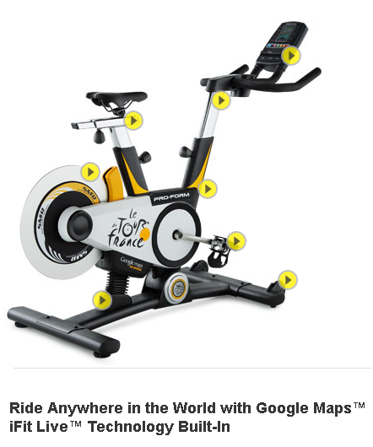
Tour de France Stationary Bicycle
Connects to the Internet through Wi-Fi
Works with iFit.com Web site
You draw maps using Google maps on iFit.com, which automatically downloads the workout to your bike
Bike follows the plan, displays overhead view
When terrain slopes up, bike tilts forward, pedaling gets harder
When terrain slopes down, bike tilts forward, pedaling gets easier
Web site displays roadside view of scenery while the bike is ridden
The product has much more limited value without an active Internet connection

Slide 30
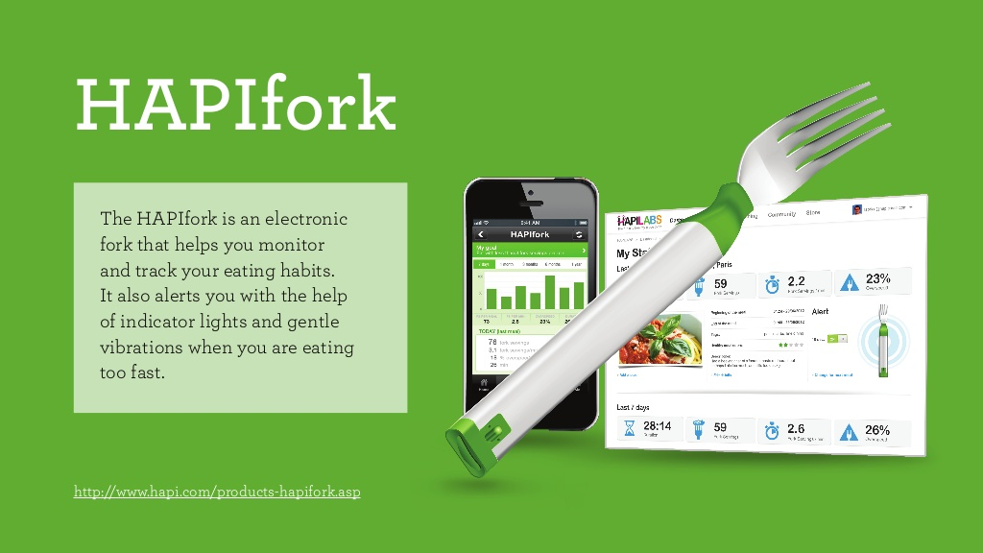

Slide 32
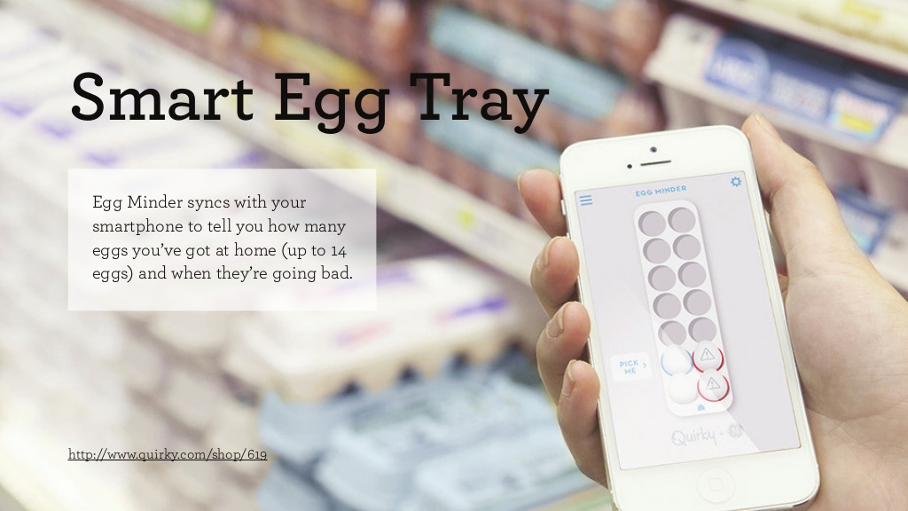

Slide 33
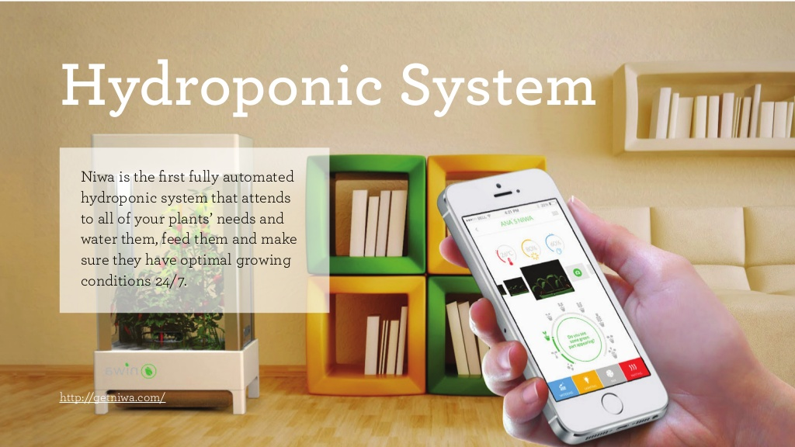

Slide 34
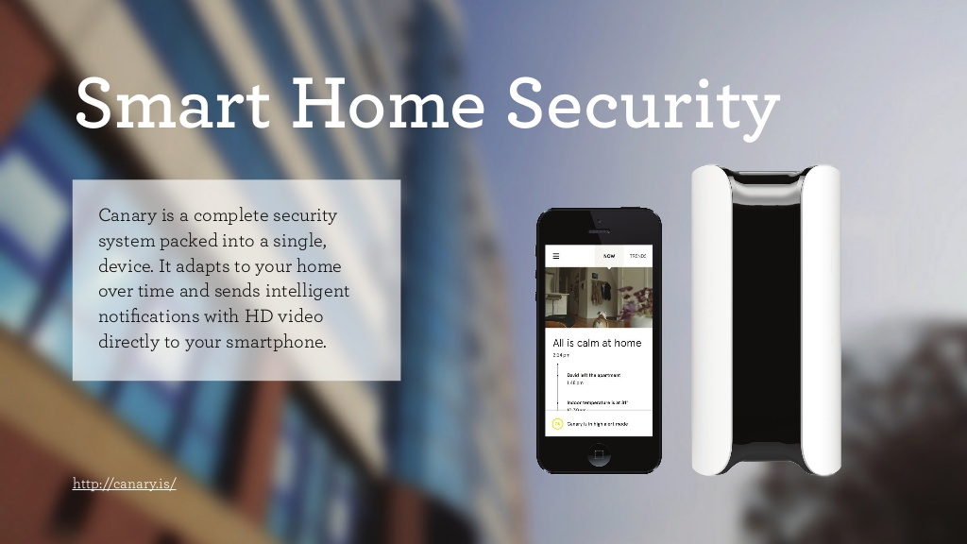

Slide 35
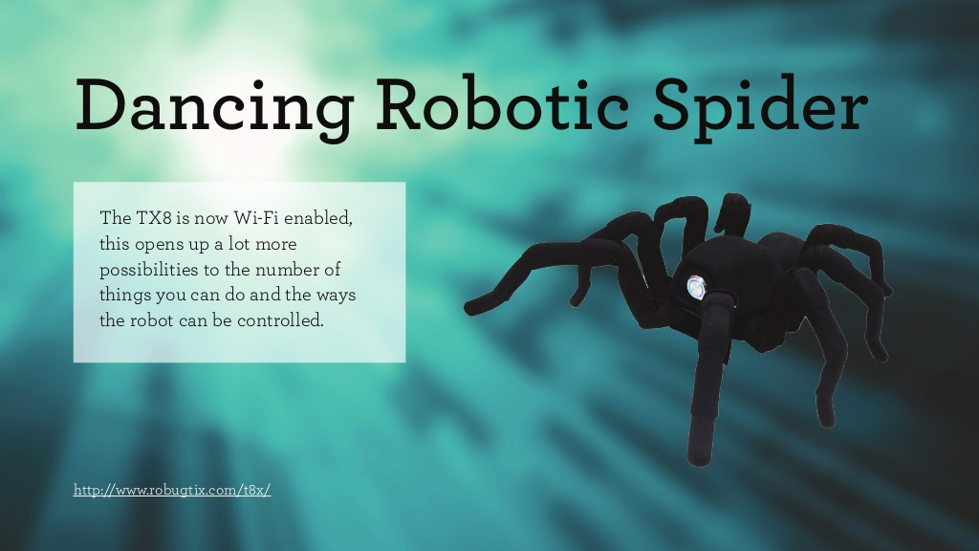

Slide 36
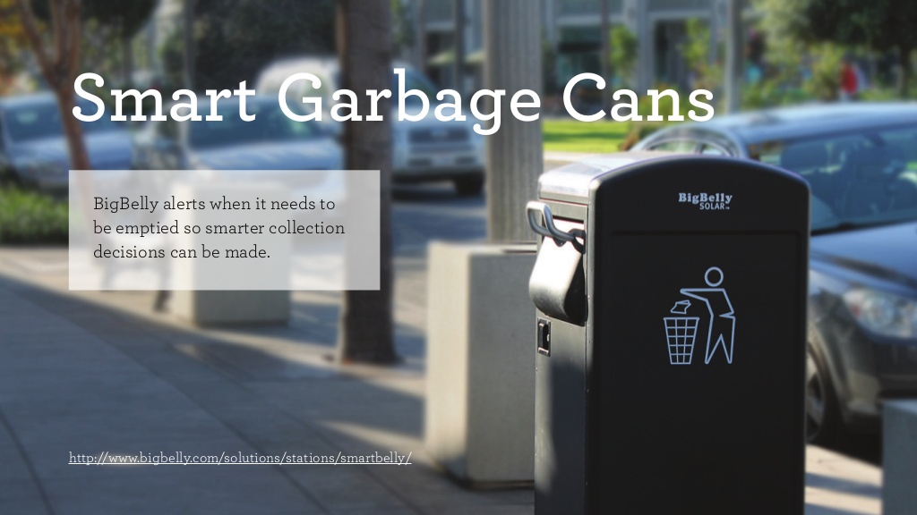

Slide 39
references
http://mckinseyquarterly.com The Internet of Things
http://wikipedia.org The Internet of Things

